Slide 1
My favourite TV-show
Victoria Levitova

Slide 2

I would like to tell you about my favourite TV-show. I am really crazy about ukrainian “master-chief”.

Slide 3
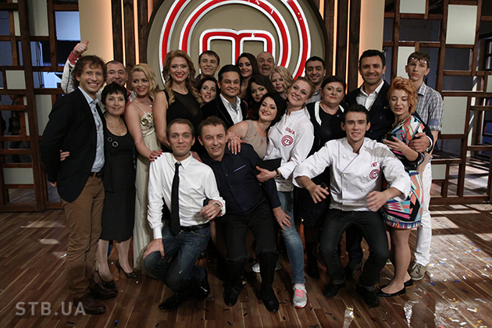
The main thing is that everyone, who thinks he has an ability to cook can go to this show and try himself in this sphere.

Slide 4
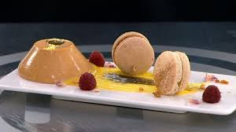
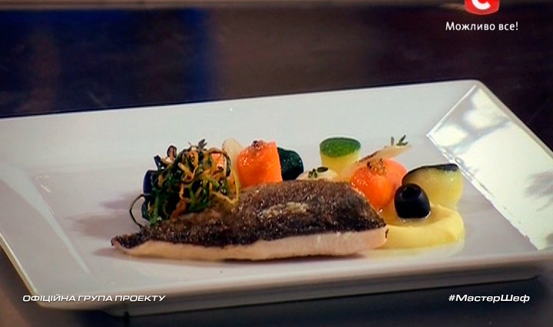
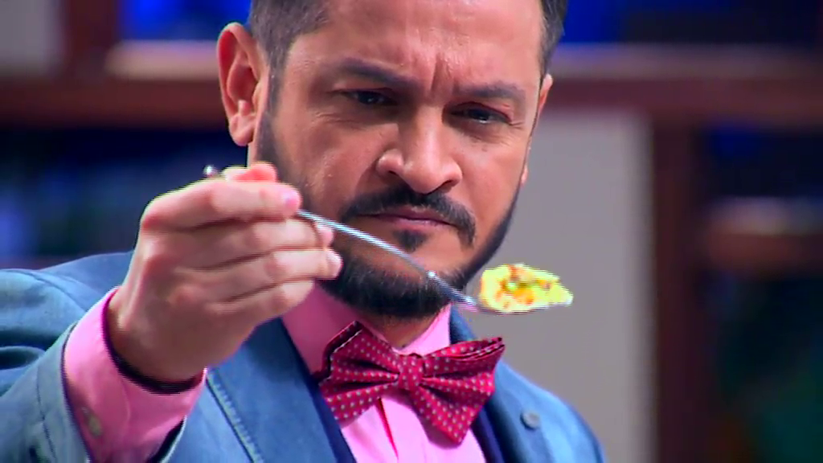
Your dishes must be tasty cooked and beautifully presented.

Slide 5
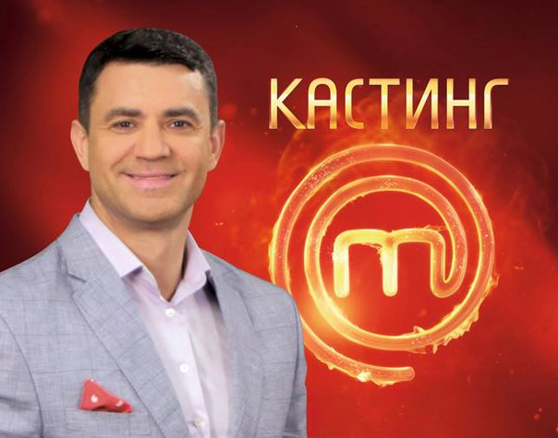
The structure of this show is the next: who wants to take part in it, should cook a dish and write the CV.

Slide 6
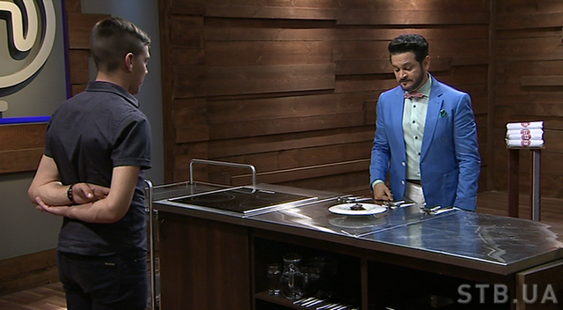
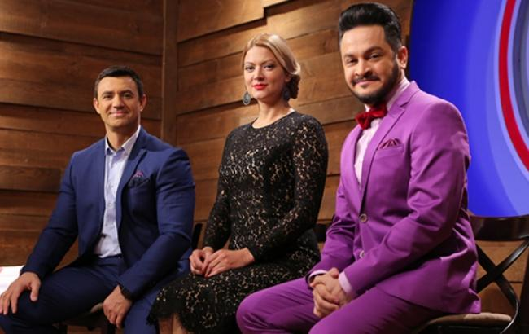
Then he or she presents all this to judges and they decide if you are ready to go further.

Slide 7
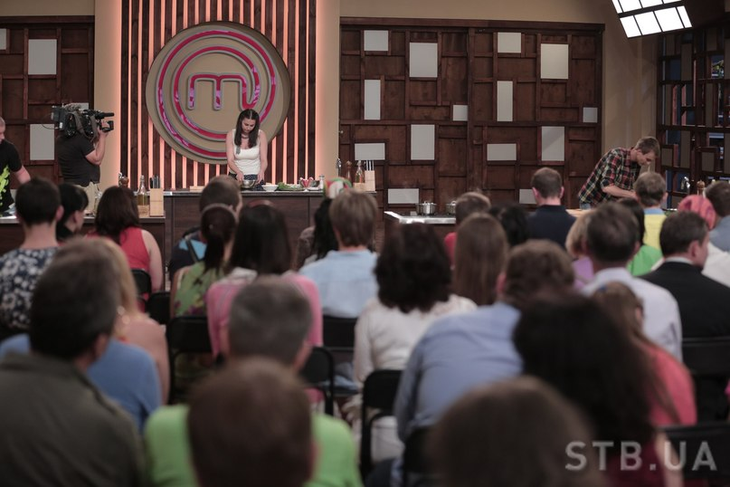
If yes, you come to the next stage and there you should also cook one perfect dish in order to continue your way in this show.

Slide 8
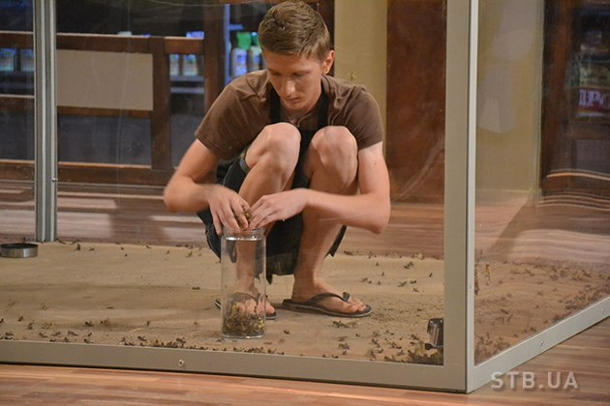
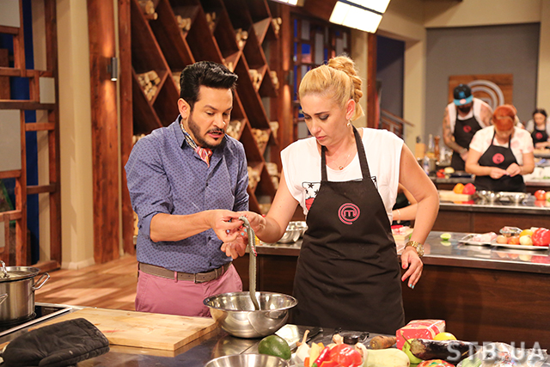
They cook different unusual dishes from unusual and even frightening ingrediens. They can cook snakes, spiders and many other difficult things

Slide 9
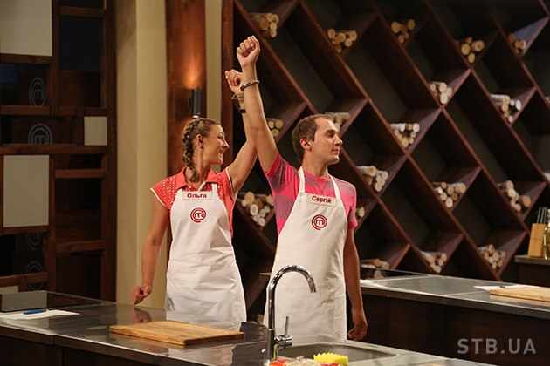
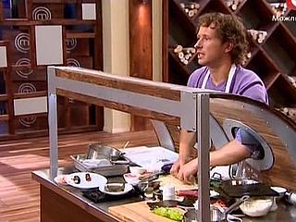
Participants of Master chief always take part in different competitions. Often they work in teams and judges create for them many difficult situations.

Slide 10
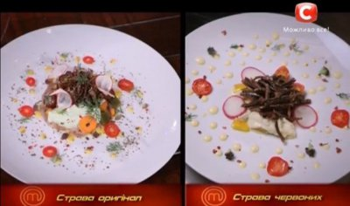
Quite often they should cook the same dish as they have seen. Sometimes they make it great.

Slide 11
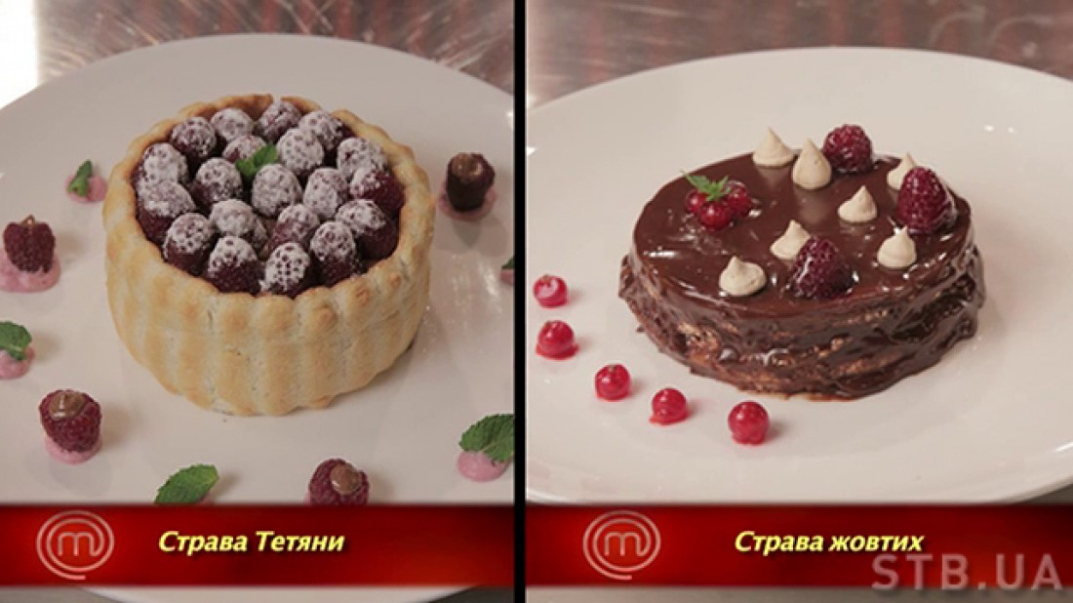
And sometimes they fail.

Slide 12
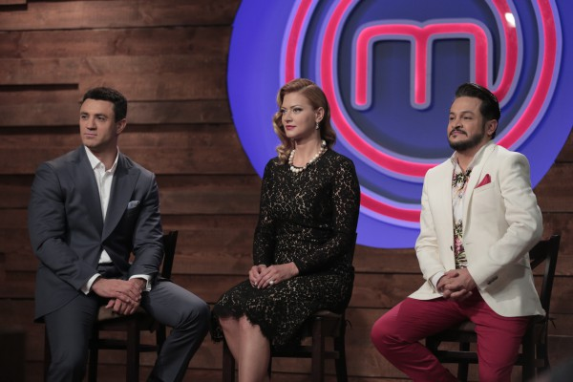
And now I will tell you about the judges of this show.

Slide 13
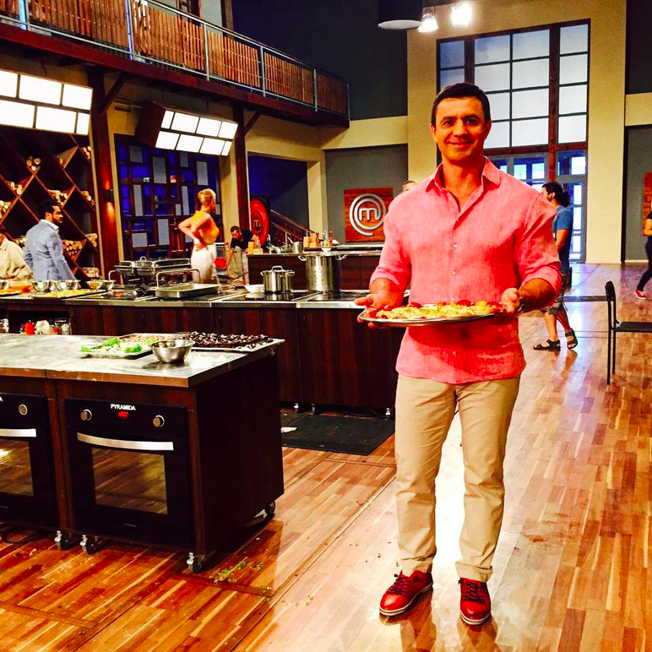
The first one is Nikolai Tishenko.

Slide 14
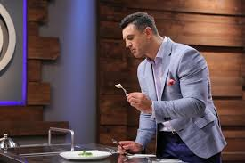
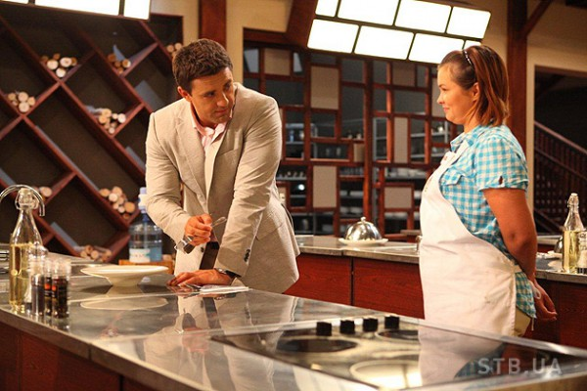
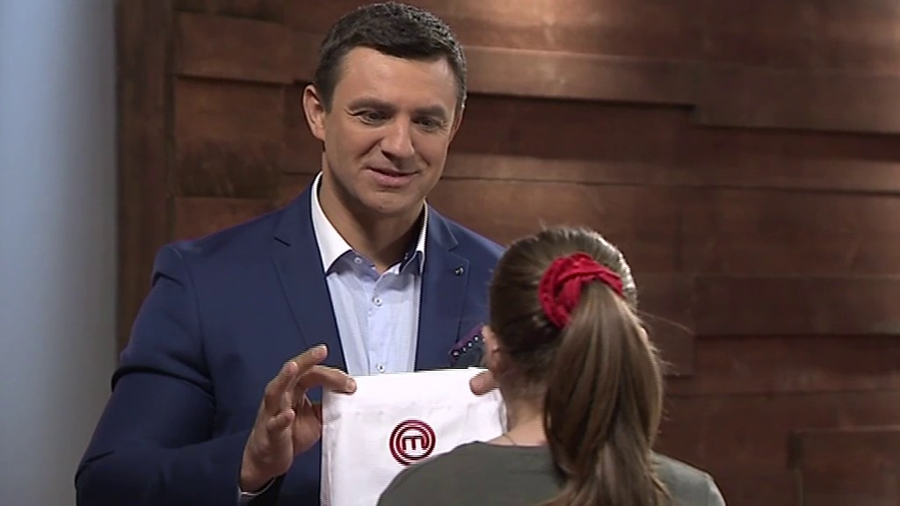
He is a famous restaurant keeper, he has many restaurants in Kiev and he looks only for qualified and gifted cookers.

Slide 15
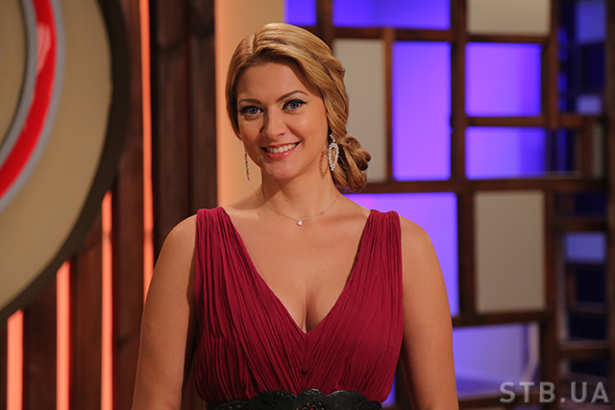
The next one is Tatyana Litvinova.

Slide 16
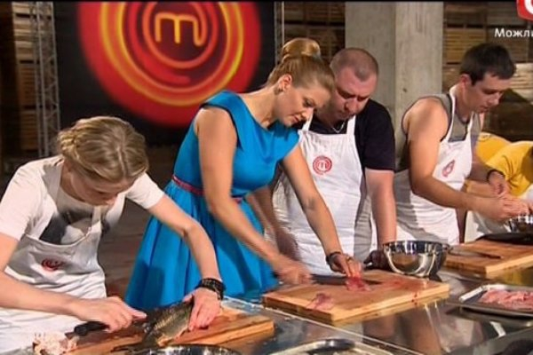
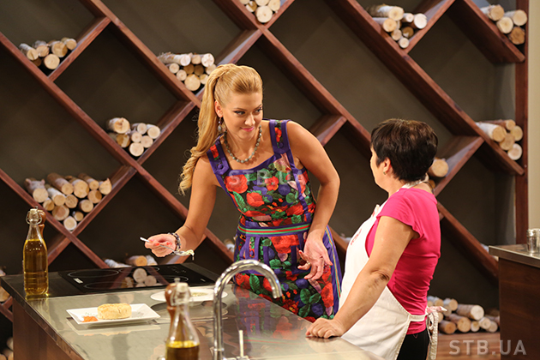
This woman is definitely smart and intelligent, she knows a lot about culinary art.

Slide 17
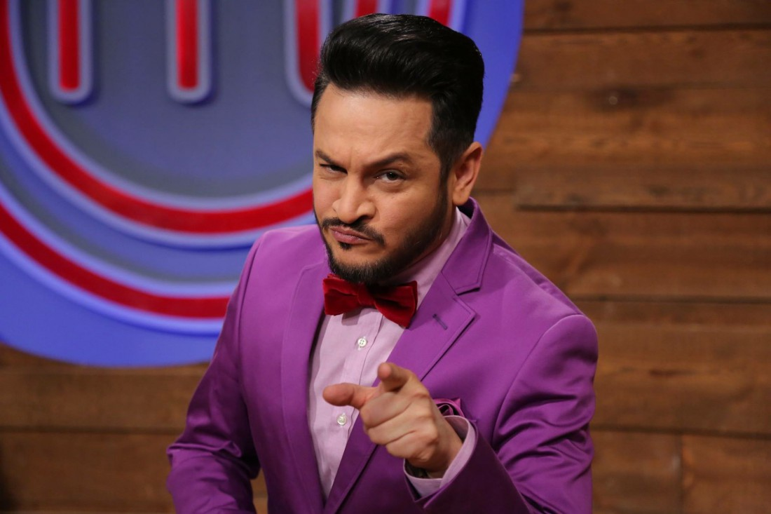
And the last one is Ector Bravo.

Slide 18
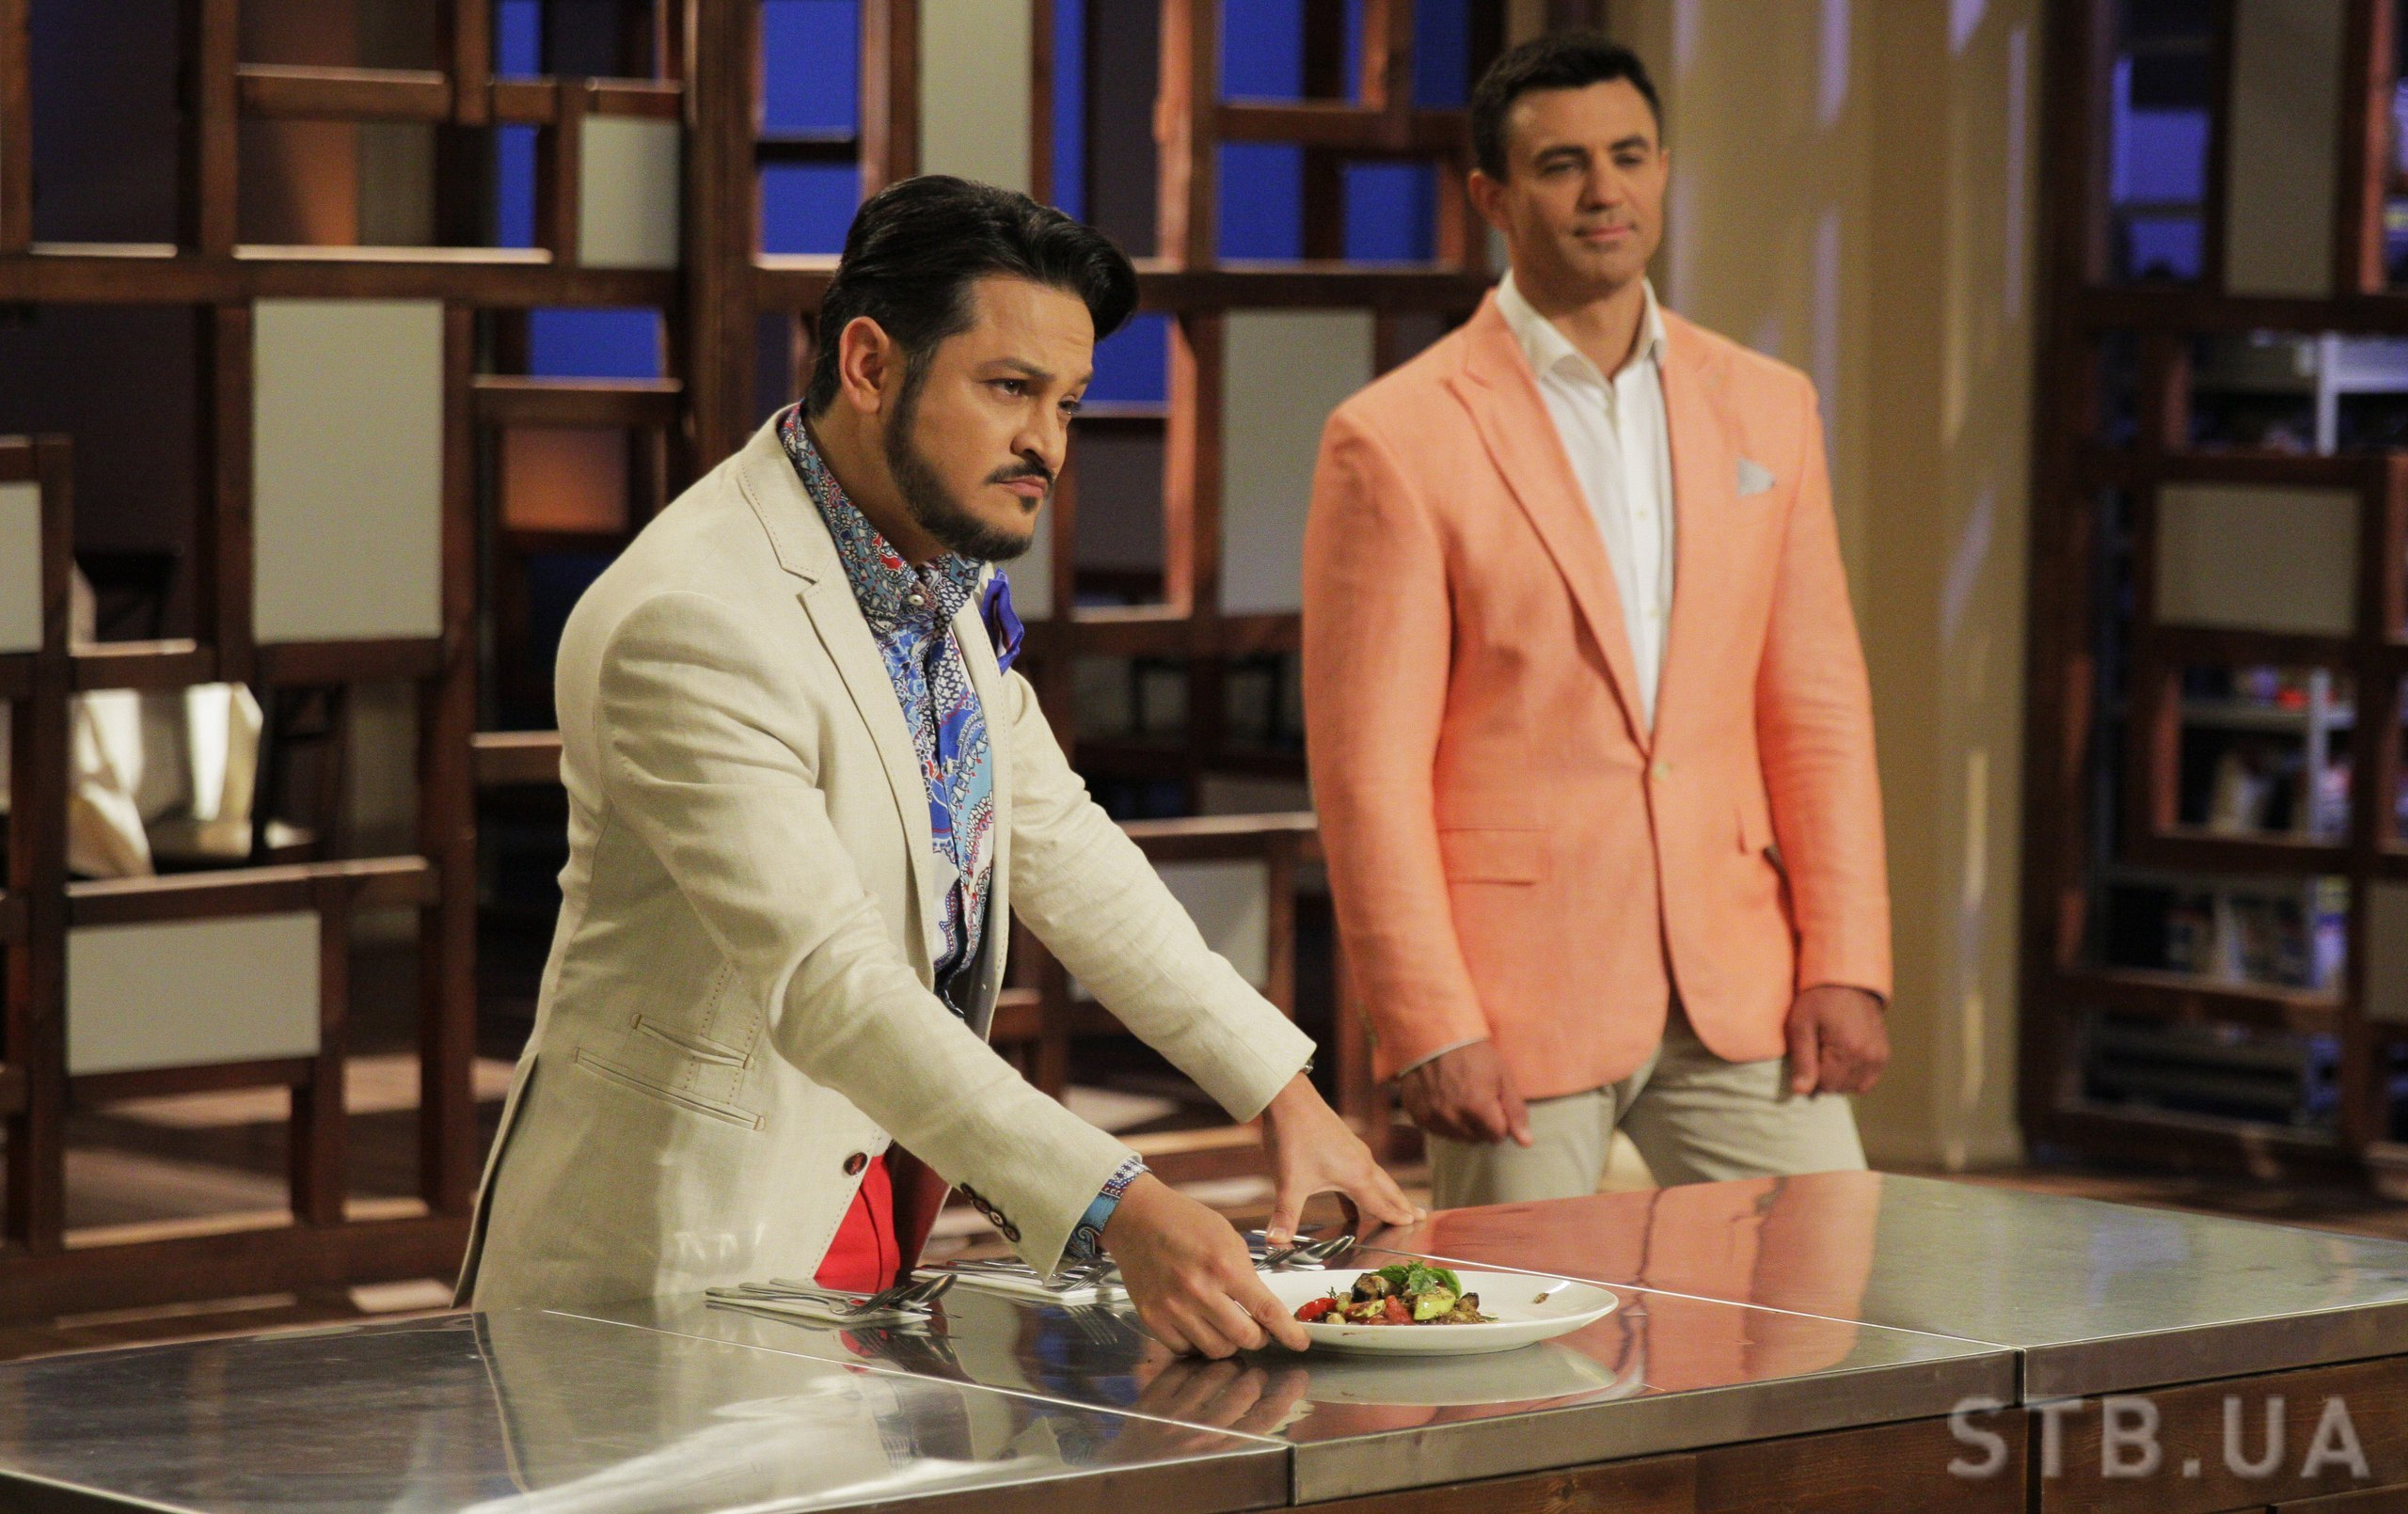
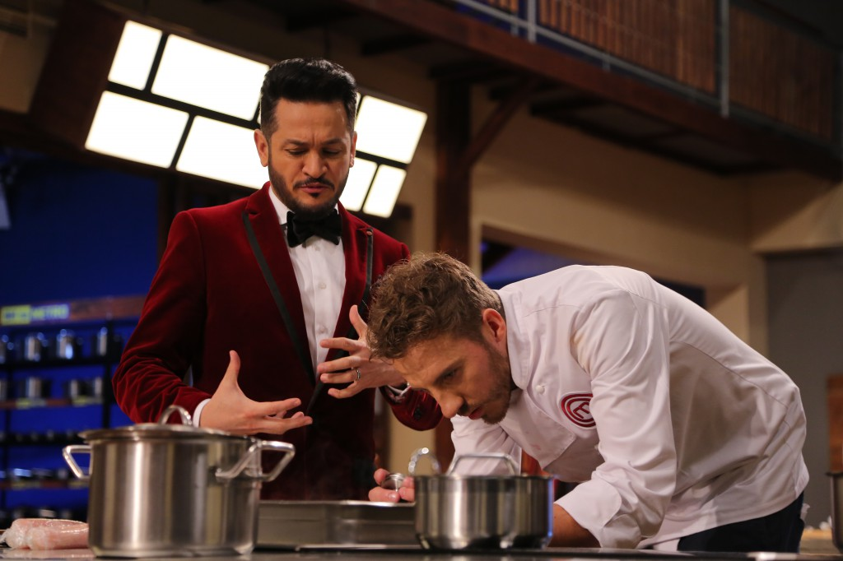
He is one of the best cookers worldwide and he believes cooking is a real magic,a real art.

Slide 19
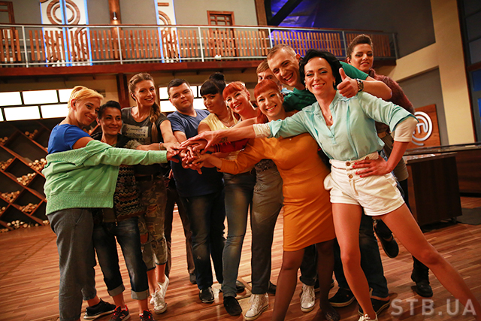
By the way, the prize is absolutely amazing I think: 500 thousand hrivnyas and studying at the most prestigious and famous culinary school “ Le cordon bleu” in France.

Slide 20
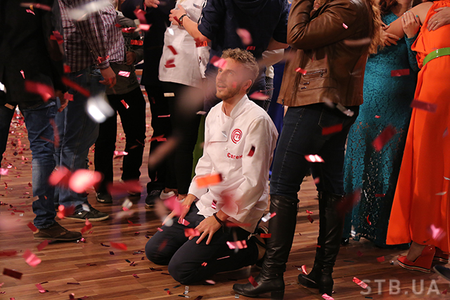
So, people, winning this prize are incredibly happy.

